Slide 1
Course Code:CSC402A Course Title: Web Architecture and Application Development
Course Leader:
Kishore S.M.
kishore.cs.et@msruas.ac.in

Slide 2
Objectives
After completing this lecture, the student will be able to
Analyze the PHP and its basics

Slide 3
Contents
PHP
PHP and database

Slide 4
PHP
PHP started out as a small open source project that evolved as more and more people found out how useful it was. Rasmus Lerdorf unleashed the first version of PHP way back in 1994.
PHP is a recursive acronym for "PHP: Hypertext Preprocessor"
PHP is a server side scripting language that is embedded in HTML. It is used to manage dynamic content, databases, session tracking, even build entire e-commerce sites
It is integrated with a number of popular databases, including MySQL, PostgreSQL, Oracle, Sybase, Informix, and Microsoft SQL Server
PHP supports a large number of major protocols such as POP3, IMAP, and LDAP. PHP4 added support for Java and distributed object architectures

Slide 5
PHP
Common uses of PHP
PHP performs system functions, i.e. from files on a system it can create, open, read, write, and close them
PHP can handle forms, i.e. gather data from files, save data to a file, through email you can send data, return data to the user
You add, delete, modify elements within your database through PHP
Access cookies variables and set cookies
Using PHP, you can restrict users to access some pages of your website
It can encrypt data

Slide 6
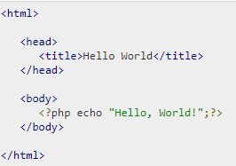
PHP
"Hello World" Script in PHP
To get a feel for PHP, first start with simple PHP scripts. Since "Hello, World!" is an essential example, first we will create a friendly little "Hello, World!" script
As mentioned earlier, PHP is embedded in HTML. That means that in amongst your normal HTML (or XHTML if you're cutting-edge) you'll have PHP statements like this −

Slide 7
PHP
PHP has a total of eight data types which we use to construct our variables −
Integers − are whole numbers, without a decimal point, like 4195
Doubles − are floating-point numbers, like 3.14159 or 49.1
Booleans − have only two possible values either true or false
NULL − is a special type that only has one value: NULL
Strings − are sequences of characters, like 'PHP supports string operations

Slide 8

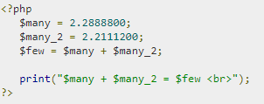

PHP
Arrays − are named and indexed collections of other values
Objects − are instances of programmer-defined classes, which can package up both other kinds of values and functions that are specific to the class
Resources − are special variables that hold references to resources external to PHP (such as database connections)

Slide 9
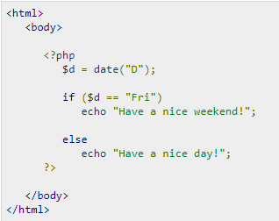
PHP
Decision making

Slide 10
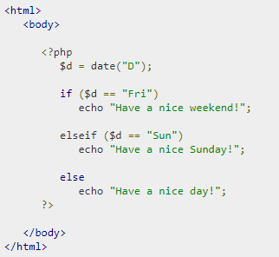
PHP
Decision making

Slide 11
PHP
PHP - GET&POST
The GET method sends the encoded user information appended to the page request. The page and the encoded information are separated by the ?character.
http://www.test.com/index.htm?name1=value1&name2=value2
The GET method produces a long string that appears in your server logs, in the browser's Location: box
The GET method is restricted to send upto 1024 characters only
Never use GET method if you have password or other sensitive information to be sent to the server

Slide 12
PHP
GET can't be used to send binary data, like images or word documents, to the server
The data sent by GET method can be accessed using QUERY_STRING environment variable
The PHP provides $_GET associative array to access all the sent information using GET method

Slide 13
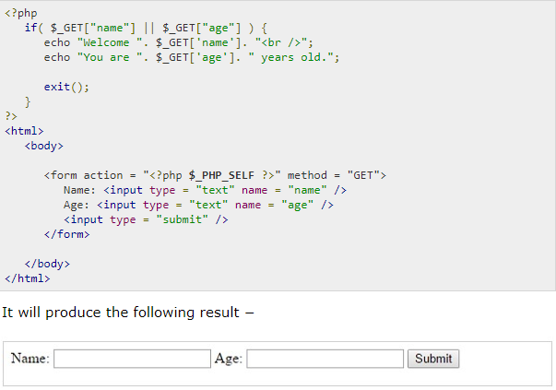
PHP
PHP - GET&POST

Slide 14
PHP
The POST Method
The POST method transfers information via HTTP headers. The information is encoded as described in case of GET method and put into a header called QUERY_STRING
The POST method does not have any restriction on data size to be sent
The POST method can be used to send ASCII as well as binary data
The data sent by POST method goes through HTTP header so security depends on HTTP protocol. By using Secure HTTP you can make sure that your information is secure
The PHP provides $_POST associative array to access all the sent information using POST method

Slide 15
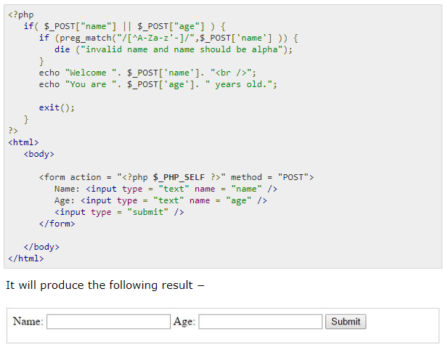
PHP
The POST Method

Slide 16
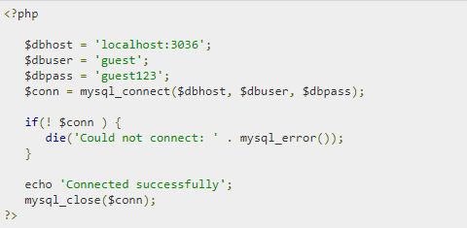
PHP
PHP & MySQL
Example to open and close a database connection

Slide 17
PHP
PHP & MySQL
Creating Database Tables
To create tables in the new database you need to do the same thing as creating the database
First create the SQL query to create the tables then execute the query using mysql_query() function

Slide 18
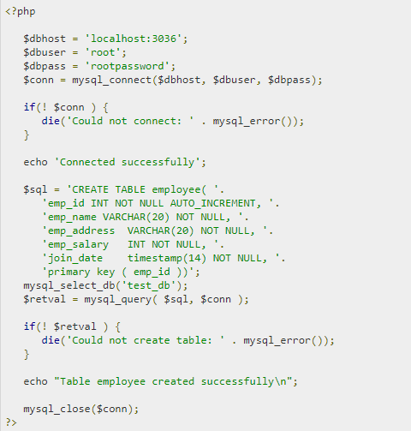
PHP
PHP & MySQL

Slide 19
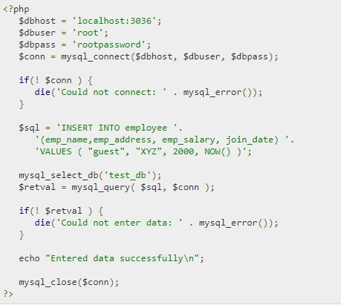
PHP
PHP & MySQL
Data can be entered into MySQL tables by executing SQL INSERT statement through PHP function mysql_query. Below a simple example to insert a record into employee table.

Slide 20
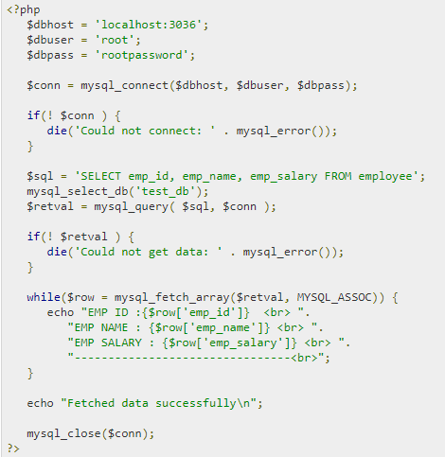
PHP
PHP & MySQL
Data can be fetched from MySQL tables by executing SQL SELECT statement through PHP function mysql_query. You have several options to fetch data from MySQL.

Slide 21
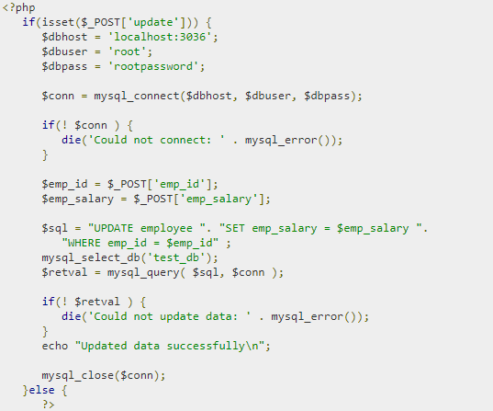
PHP
PHP & MySQL
Data can be updated into MySQL tables by executing SQL UPDATE statement through PHP function mysql_query.

Slide 22
Summary
PHP is a recursive acronym for "PHP: Hypertext Preprocessor“
PHP is a server side scripting language that is embedded in HTML

